Slide 1
FSC-A Scaling

Slide 2
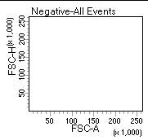
Area and Height of FSC pulses must be the same.
45°

Slide 3
WHY?

Slide 4
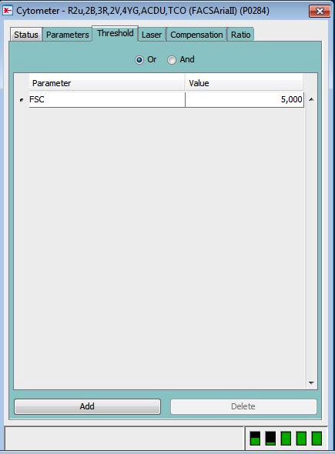
The FSC threshold value is based on the FSC pulse height. NOT area
The value of 5000 is not relevant on the FSC-A axis since FSC-A ≠ FSC-H by default

Slide 5
WHY does FSC-A≠ FSC-H?
The laser is only 8 um high and the cell is larger than the 8 um
EXCEPTION, these cells are not larger than 8um: bacteria, yeast and RBC’s or platelets

Slide 6
The pulse flattens out on top because the cell is larger than the laser.
Without being fully illuminated the FSC-H pulse can never reach its true maximum
FSC-A will always be equal to the full FSC value of the cell, therefore FSC-A> FSC-H IF the cell is larger than the laser
B
C
D
D
C
B
laser
A

Slide 7
You must multiply the FSC-A by some number less than 1 to make the FSC-A = FSC-H

Slide 8
HOW?

Slide 9
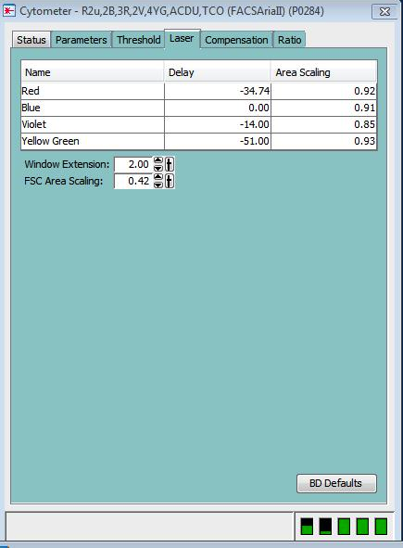
Adjust the FSC-A Scaling number so the cells fall on a 45° angle on a FSC-A vs. FSC-H plot

Slide 10
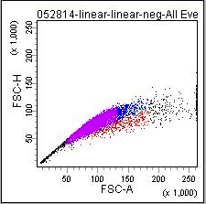
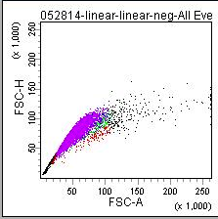
BEFORE
FSC Area Scaling adjustment
FSC Area Scaling= 0.75
AFTER
FSC Area Scaling adjustment
FSC Area Scaling= 0.42

Slide 11
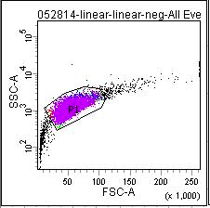
Now the threshold value of 5000 has relevance on a FSC-A vs. SSC-A plot
= debris
P1= live cells
= dead cells

Slide 12
In conclusion…
FSC threshold is based on the FSC-H
Adjust the FSC-A using the FSC-A Scaling under cytometer window> laser tab
So FSC-A= FSC-H by placing the cells on a 45° angle on a FSC-A vs. FSC-H plot

